Slide 1
Check sound!
Q: = Everyone Stand Up

Slide 2

Enterprise Software Development

Slide 3

WHAT’S NEW IN Angular2 & ASP.NET 5
@Adamstephensen | Solution Architect @ SSW

Slide 4
Who are you ? What are you working on? What are you looking to take away?

Slide 5

Adam Stephensen
http://adamstephensen.com
@AdamStephensen
Solution Architect at SSW
Building Awesome Teams and Software
Focus on Enterprise Web and Development Best Practices
Principal Mentor @ FireBootCamp
Microsoft Australia Partner Award for Learning

Slide 6

Duncan Hunter
htttp://duncanhunter.com.au
@DuncHunter​
Software Architect at SSW​
Rocking Angular/TypeScript ​
Rock climber

Slide 7
Who’s using angular 1?
Notes:
o o o Who’s using asp.net webforms ?
o Who’s using asp.net mvc ?
o Using using latest mvc vnext ?
o Who’s not a .net developer and just nere for angular ?

Slide 8
Who’s using angular 2 ?
Notes:
o o Who’s using angular 2 ?
o Who’s using asp.net webforms ?
o Who’s using asp.net mvc ?
o Using using latest mvc vnext ?
o Who’s not a .net developer and just nere for angular ?

Slide 9
Who’s using ASP.net MVC ?
Notes:
o o Who’s using angular 2 ?
o Who’s using asp.net webforms ?
o o Using using latest mvc vnext ?
o Who’s not a .net developer and just nere for angular ?

Slide 10
Who is using latest MVC vNext?
What version is it?
Notes:
o o Who’s using angular 2 ?
o Who’s using asp.net webforms ?
o Who’s using asp.net mvc ?
o Using using latest mvc vnext ?
o Who’s not a .net developer and just nere for angular ?

Slide 11
Who’s using TypeScript
Notes:
o o Who’s using angular 2 ?
o Who’s using asp.net webforms ?
o o Using using latest mvc vnext ?
o Who’s not a .net developer and just nere for angular ?

Slide 12
Who has a build task?
Grunt
gulp
JSPM
WebPack
Other ?

Slide 13
What are you most interested in learning ? - What’s new in ASP.Net MVC - Angular 1 - Angular 2
Notes:
o o Who’s using angular 2 ?
o Who’s using asp.net webforms ?
o o Using using latest mvc vnext ?
o Who’s not a .net developer and just nere for angular ?

Slide 14
The Past and the Vision
Where were we last year ?
Where are we going ?
Why are we here now ?
Notes:
o o Who’s using angular 2 ?
o Who’s using asp.net webforms ?
o o Using using latest mvc vnext ?
o Who’s not a .net developer and just nere for angular ?

Slide 15
The Pain
The bottom line:
if you want to be really good at your job..
the next 12 months are going to hurt.
they are going to be fun, and interesting, and you’ll learn a heap .. but it’s going to hurt.

Slide 16
File | New | ???????
Front End ?
Back end ?
Architectural choice?
Deployment?
Notes:
Angular 2 or React…. or another javascript framework.. they are going to change every few years. LIVE WITH IT…. or become a backend guy
many many more best practices around front end dev. it’s going to get the same attendion that back end dev has the moral of this story -> javascript dev is growing up. (Some people are even going to start saying it’s a real language)
in the dot net space -> massive fundamental breaking changes. benefis for today to upgrading to .net 5…. almost tnothing.

Slide 17
WHAT’S NEW IN ASP.NET 5
@Adamstephensen | Solution Architect @ SSW

Slide 18

New Developer Goodies
Roslyn, Dnx, Dnx, Dnvm
Package Managers (NPM, Bower, NuGet)
Front End Build Process (Gulp or Grunt)
wwwroot
.json everywhere

Slide 19
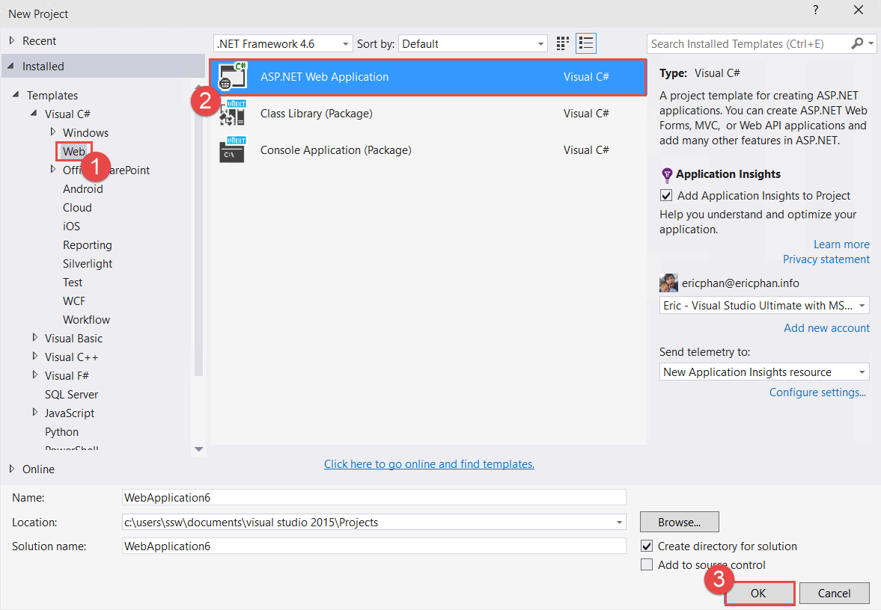

Slide 20
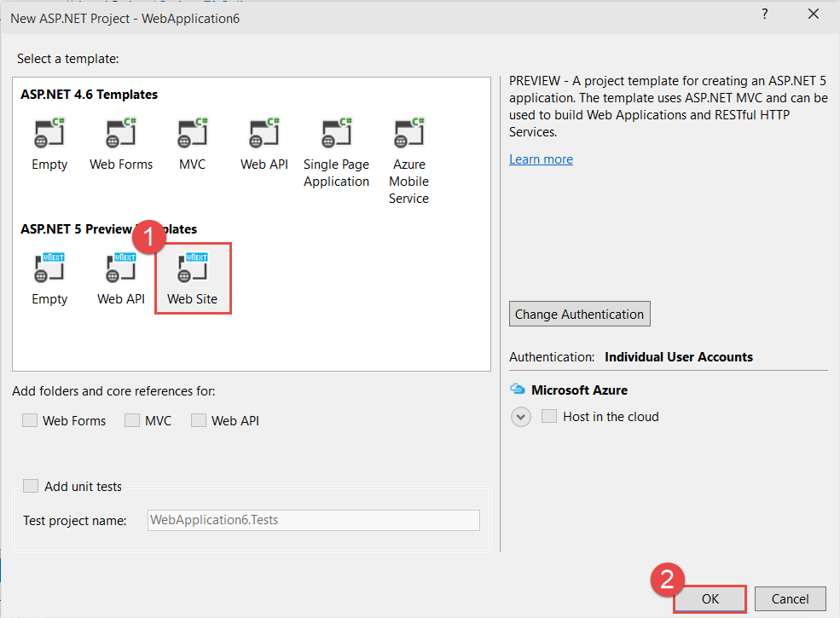

Slide 21
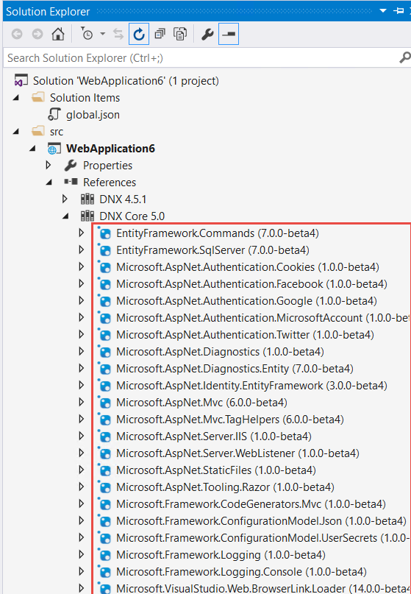
Everything is a NuGet package
Restoring packages for c:\users\ericphan\documents\visual studio 14\Projects\WebApplication3\WebApplication3\project.json
Attempting to resolve dependency WebApplication3 >= 1.0.0
Attempting to resolve dependency EntityFramework.SqlServer >= 7.0.0-alpha2
OPEN EntityFramework.SqlServer.7.0.0-alpha2.nupkg
OPEN EntityFramework.SqlServer.7.0.0-alpha2\EntityFramework.SqlServer.7.0.0-alpha2.nuspec
Attempting to resolve dependency Microsoft.AspNet.Mvc >= 6.0.0-alpha2
OPEN Microsoft.AspNet.Mvc.6.0.0-alpha2.nupkg
OPEN Microsoft.AspNet.Mvc.Common.6.0.0-alpha2.nupkg
: :
OPEN Microsoft.AspNet.Mvc.Razor.Host.6.0.0-alpha2\Microsoft.AspNet.Mvc.Razor.Host.6.0.0-alpha2.nuspec
Attempting to resolve dependency EntityFramework.Migrations >= 7.0.0-alpha2
OPEN EntityFramework.Migrations.7.0.0-alpha2.nupkg
OPEN EntityFramework.Migrations.Design.7.0.0-alpha2.nupkg
OPEN EntityFramework.Migrations.7.0.0-alpha2\EntityFramework.Migrations.7.0.0-alpha2.nuspec
OPEN EntityFramework.Migrations.Design.7.0.0-alpha2\EntityFramework.Migrations.Design.7.0.0-alpha2.nuspec

Slide 22
Rosyln, Dnu, Dnx, Dnvm

Slide 23
New terms for the .NET Developer
DNVM
DNU
DNX
Roslyn
OWIN
.Net Core

Slide 24
ASP.NET 5 - DNX, DNVM, DNU?
DNX – Runtime Environment
Code required to bootstrap and run an ASP.NET 5 application.
DNVM – Version Manager
Updating and installing different versions of DNX. DNVM is also used to set default DNX version.
DNU – Development Utility
Manages packages needed by applications to run, publish application etc
https://github.com/aspnet/home choose Stable(ish) or Optimistic
Notes:
Dnvm list
Dnu restore

Slide 25
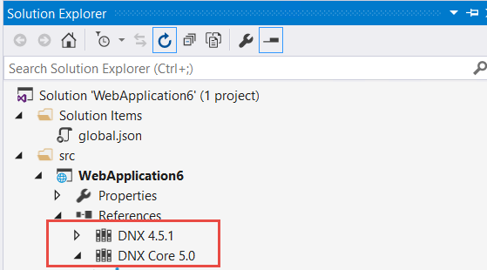
3. DNX 4.5.1 and DNX Core

Slide 26
DNX Core
Is a cross platform .NET library that can run on other platforms.
Should you target this by default?

Slide 27
DNX 4.5.1
This is the full .NET Framework that has extra API calls
Use this if there are extra features you need or if you don’t care about running your Web applications on a linux server

Slide 28
DNX
You can change which you target in the project’s properties page

Slide 29
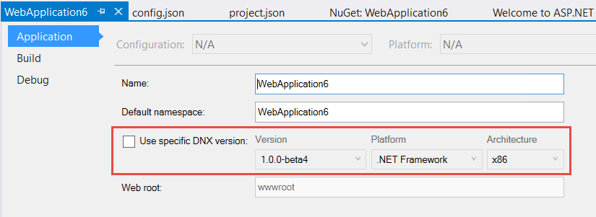

Slide 30
Package Managers

Slide 31
Problems with Nuget…
Libraries not always up to date
People would download latest files from Github
No tooling for building the front end… MVC Bundler is ok but not good enough…
Nuget is mainly for Visual Studio developers

Slide 32

bower.json
Bower is a front end javascript package manager (created by Twitter)
bower.json
{
"name": "WebApplication",
"private": true,
"dependencies": {
"bootstrap": "3.0.0",
"jquery": "1.10.2",
"jquery-validation": "1.11.1",
"jquery-validation-unobtrusive": "3.2.2",
"hammer.js": "2.0.4",
"bootstrap-touch-carousel": "0.8.0"
},
"exportsOverride": {
"bootstrap": {
"js": "dist/js/*.*",
"css": "dist/css/*.*",
"fonts": "dist/fonts/*.*"
},
:
}

Slide 33
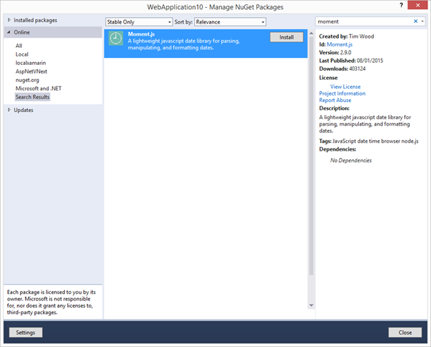
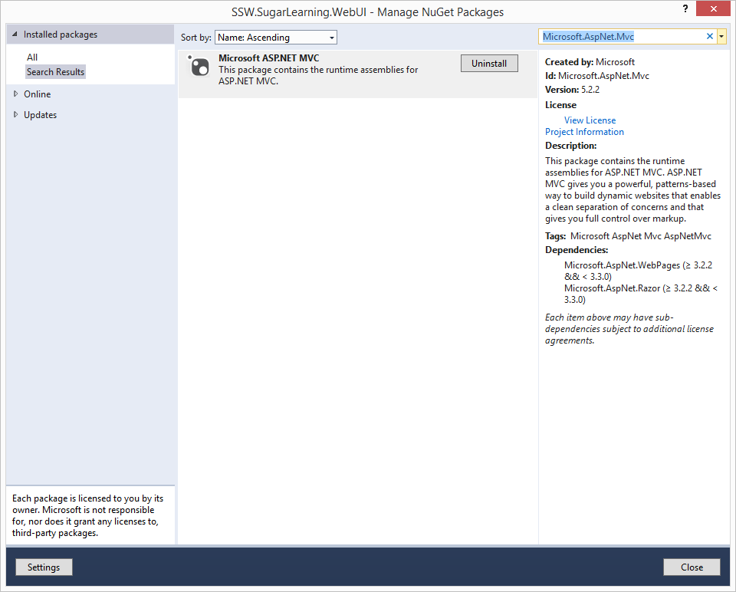

Before:

Slide 34
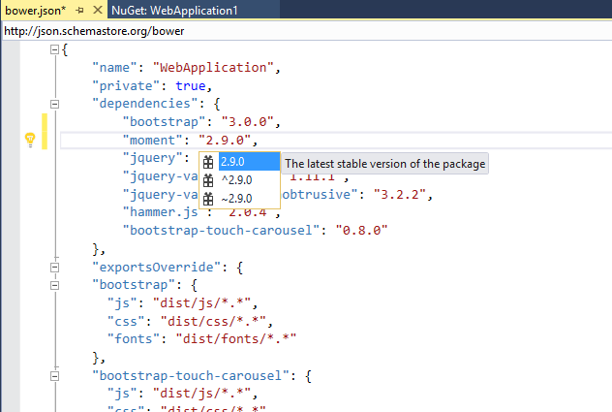
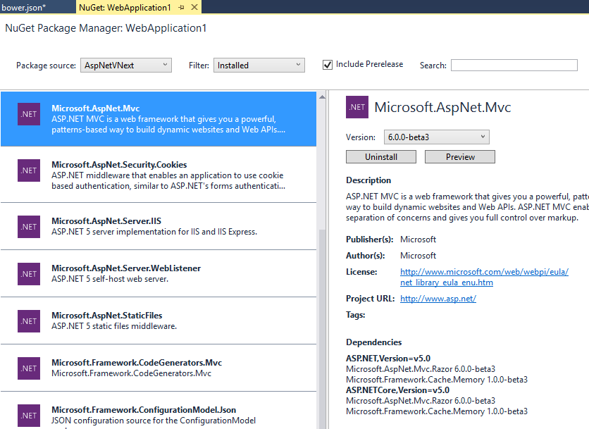
Now… bower.json
Front end libraries in bower.json
ASP.NET libraries in Nuget

Slide 35

package.json (frontend work)
List of NPM (Node Package Manager) packages
NPM is a javascript package manager for development tasks (e.g. minification, bundling, sass, less, image optimization)
package.json
{
"version": "0.0.0",
"name": "",
"devDependencies": {
"grunt": "0.4.5",
"grunt-beautify": "0.1.1",
"grunt-jslint": "1.1.12",
"grunt-bower-task": "0.4.0"
}
}

Slide 36

New terms – Package Managers
Bower
NPM
Nuget
<Next PBI – create a cool logo>

Slide 37
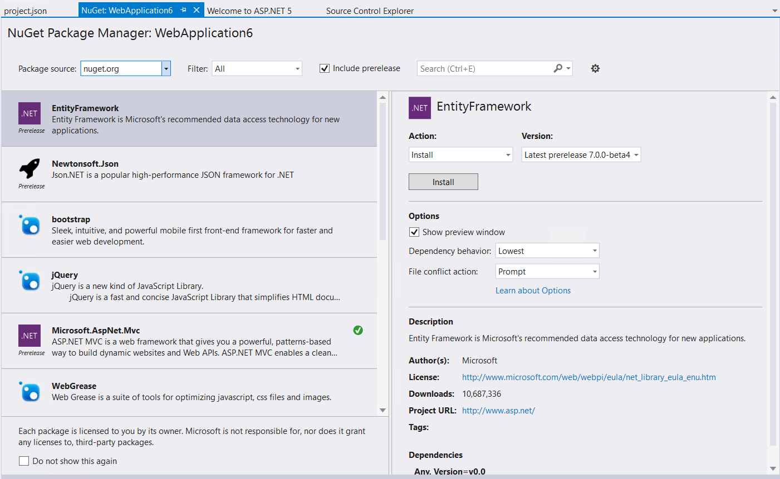

Slide 38
New NuGet Package Manager
Looks nicer
Makes it easier to install other version of NuGet packages

Slide 39
What goes where?
NuGet - .NET Dependencies (eg. SignalR, Owin)
Bower – Frontend Javascript Dependencies (eg. jQuery, Angular)
NPM – Backend Javascript Dev Tools (eg. lodash, browserify, watchify, grunt, JSHint)
Grunt/Gulp – MSBuild for client side files (eg. Bundling)

Slide 40
Which to use where?
Bye bye bower?

Slide 41
Front End Build

Slide 42
We now need a build process for our frontends not just our backends.

Slide 43


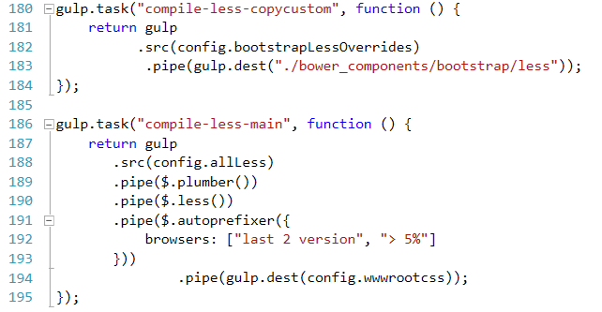
gulpfile.js (build frontend)
A javascript task runner (installed by npm)
Use it to process your js and css files
Minification / Uglification
Less / Sass
Beautify / Prettify
Bundling…
Notes:
We now need a build process for our frontends not just our backends.
A typical front end build process involves
Compiling less to css
Compiling typescript to javascript
Building sourcemaps and javascript reference files
Running javascript linters and unit tests
Bundling and minification
To do this we use a javascript task runner like Grunt or Gulp.

Slide 44

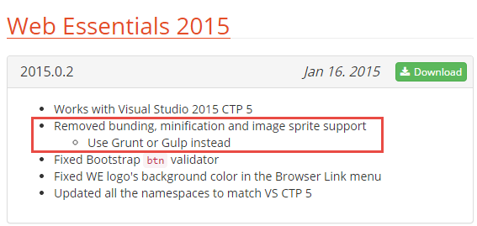
gruntfile.js (build frontend)
A javascript task runner (installed by npm)
Use it to process your js and css files
Minification / Uglification
Less / Sass
Beautify / Prettify
Bundling…
gruntfile.js
module.exports = function (grunt) {
grunt.initConfig({
bower: {
install: {
options: {
targetDir: "wwwroot/lib",
layout: "byComponent",
cleanTargetDir: false
}
}
}
});
grunt.registerTask("default", ["bower:install"]);
grunt.loadNpmTasks("grunt-bower-task");
};

Slide 45
Instead use the task runner Gulpjs
Notes:
This is what my colleague and many are saying is a no brainer these days for a new project.
Another way of saying this is to have a build process
We have been building our server side code for ages but now we have to build our client side code
- minify, rename, concat and rearrange etc
The Microsoft and Visual Studio is going
Automate processes
More time to set up
It gets easier

Slide 46

Gulp versus Grunt
Gulp JS
Stream based so less read/write
Code over configuration
1500+ plugins
Grunt JS
File based
Configuration over code
3000+ plugins
Notes:
You write code versus config files

Slide 47
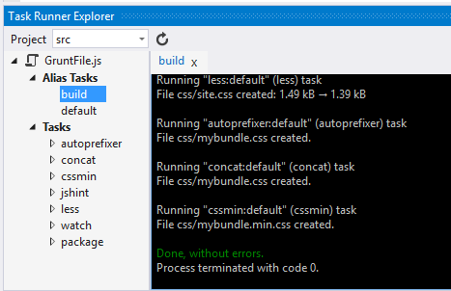
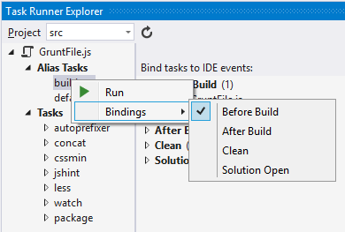
Visual Studio task runner explorer
Notes:
We use the task runner explorer for 2015 but
Currently can not do both 2015 and 2013 but will be fixed

Slide 48
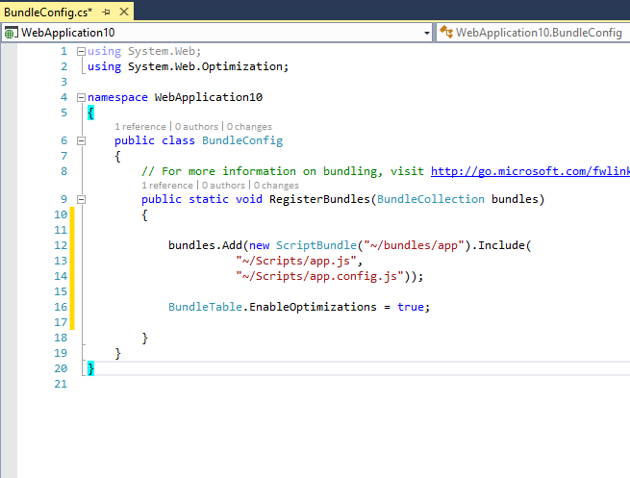
Bundling and Minification… Before App_Start folder

Slide 49
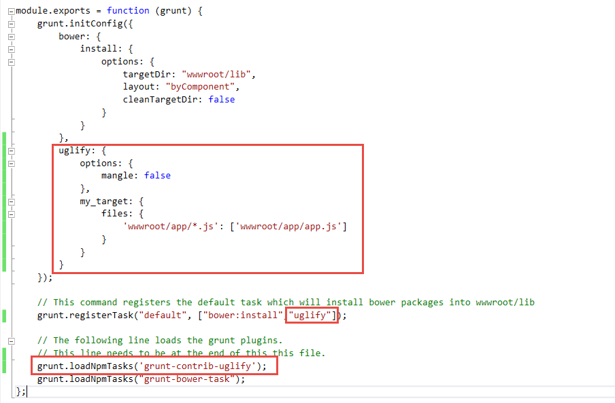
Bundling and Minification… VS2015 gruntfile.js (build frontend)

Slide 50

New terms – Front End Build
Gulp
Grunt

Slide 51
wwwroot

Slide 52
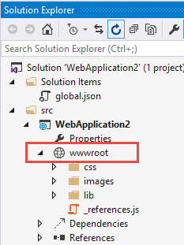
9. wwwroot?
Static files go here (*.js, *.png, *.jpg)
Maps to http://hostname/
Cleaner separation between code files and static files
TypeScript, LESS should not be put in here, only the output of these files should be placed in here
Notes:
TODO: Rule on this

Slide 53
.json everywhere

Slide 54
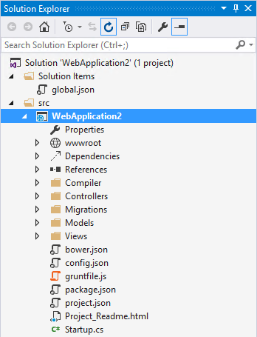
No more .csproj
project.json
config.json (no more web.config)
package.json (no more packages.config)

Slide 55
project.json
Add references to NuGet packages here
Full intellisense
IIS/Hosting configuration

Slide 56
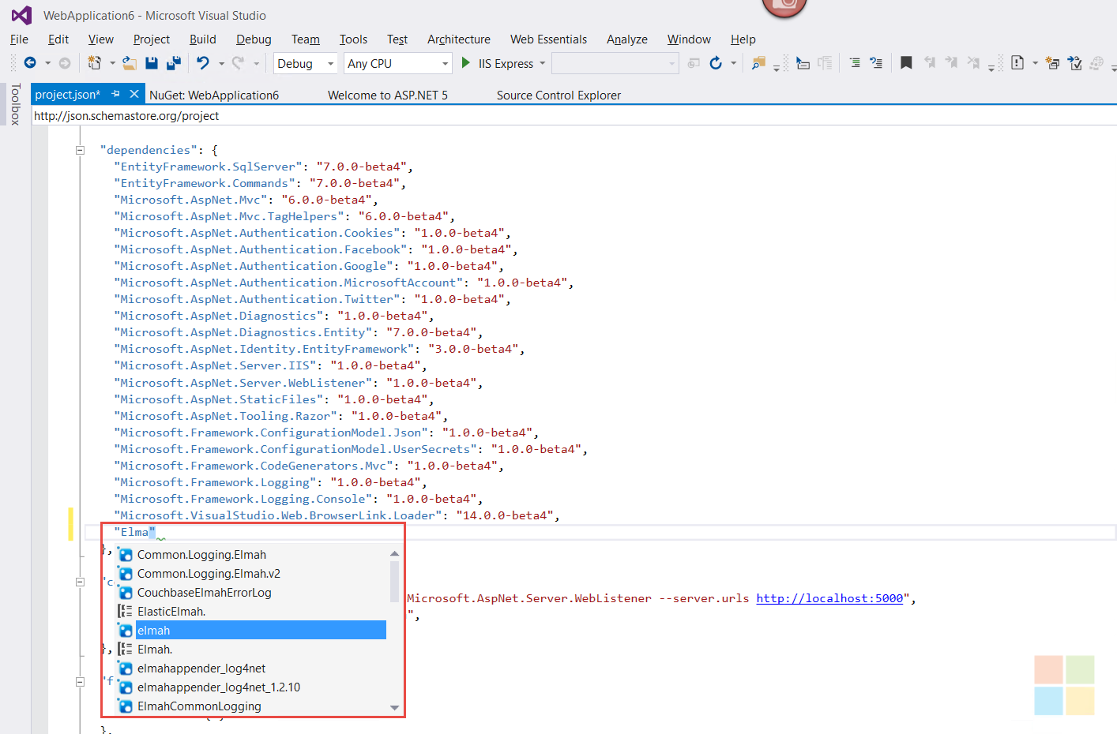

Slide 57
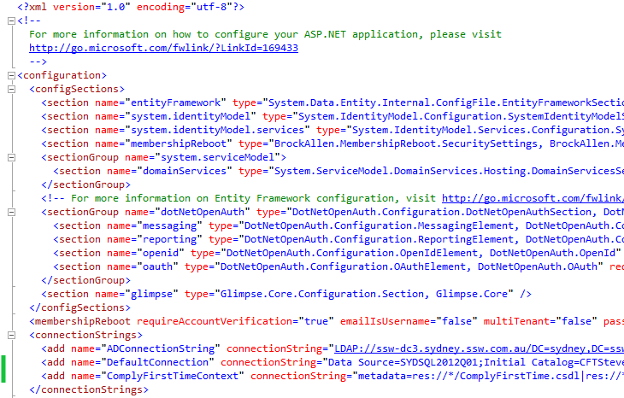
Web.config

Slide 58
config.json
Stores connection strings and other app settings
{
"Data": {
"DefaultConnection": {
"ConnectionString": "Server=(localdb)\\mssqllocaldb;Database=aspnetvnext-WebApplication3-15606acb-81ef-4c1e-97c1-ac0b2d4e4a33;Trusted_Connection=True;MultipleActiveResultSets=true"
}
}
}

Slide 59
WebAPI and Controllers in one
public class ValuesController : Controller { // GET /values public string Get() { return "Values"; } // GET /values/1 public string Get(int id) { return "Value " + id.ToString(); } // POST /values public ActionResult Post() { return new HttpStatusCodeResult(201); } }
http://rules.ssw.com.au/SoftwareDevelopment/RulesToBetterWebAPI/Pages/Default.aspx

Slide 60
View components

Slide 61
Razor Tag Helpers

Slide 62
14. Razor Tag Helpers
Old
@Html.ActionLink(“Click me”, “View”, “Controller”)
New
<a asp-controller=“Controller” asp-view=“Index”>Click me</a>

Slide 63
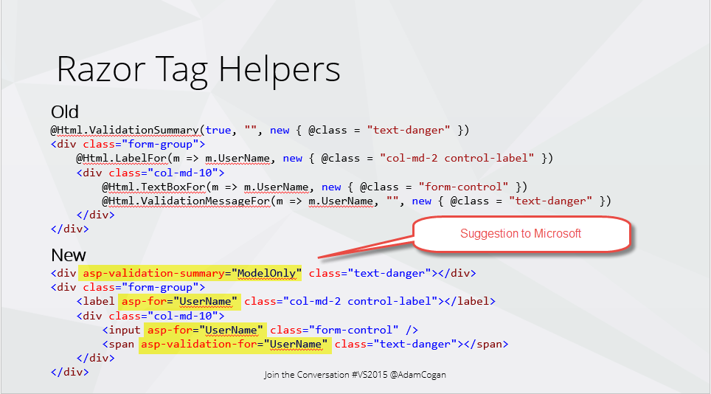
Razor Tag Helpers
Old
@Html.ValidationSummary(true, "", new { @class = "text-danger" })
<div class="form-group">
@Html.LabelFor(m => m.UserName, new { @class = "col-md-2 control-label" })
<div class="col-md-10">
@Html.TextBoxFor(m => m.UserName, new { @class = "form-control" })
@Html.ValidationMessageFor(m => m.UserName, "", new { @class = "text-danger" })
</div>
</div>
New
<div asp-validation-summary="ModelOnly" class="text-danger"></div>
<div class="form-group">
<label asp-for="UserName" class="col-md-2 control-label"></label>
<div class="col-md-10">
<input asp-for="UserName" class="form-control" />
<span asp-validation-for="UserName" class="text-danger"></span>
</div>
</div>

Slide 64
Razor Tag Helpers
More HTML like
More readable
More control over how the HTML outputs
Harder to tell server side code from client side code

Slide 65
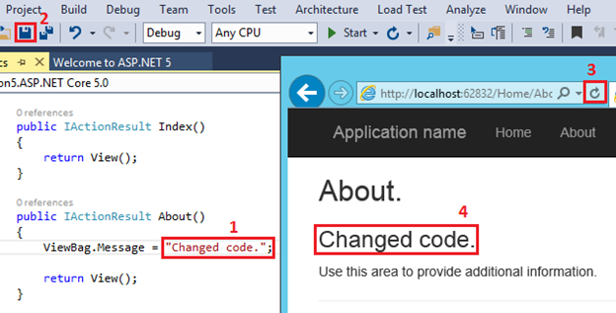
No need to hit build, just save and refresh (powered by Roslyn)

Slide 66
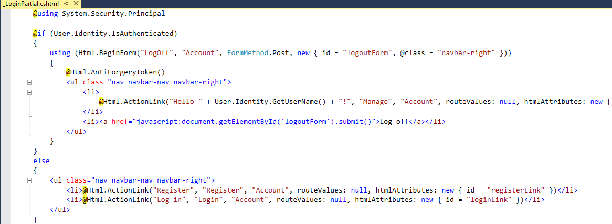
MVC – Partials… the problems
Could get messy with if statements blocks mixed with html
How can I test?

Slide 67
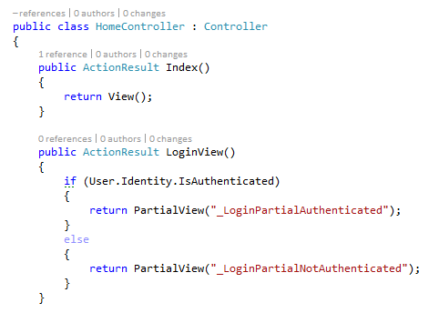
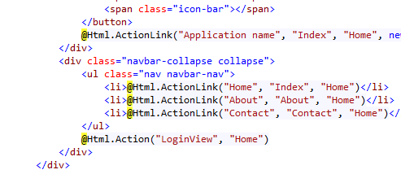
The fix… put the logic in a controller
Create an action on the controller that has the logic
Render the action on the page
Fixes the problem but…
Partials now combined with controllers
Make controllers fat
Component is not completely separate

Slide 68
Or use… New - View Components
Similar to partial views, but more powerful.
Includes the same separation-of-concerns + testability found between a controller and view.
Like a mini-controller—responsible for rendering a chunk rather than a whole response.
Can solve any problem that is too complex or messy with a partial, such as:
Login panel
Dynamic navigation menus
Tag cloud (where it queries the database)
Shopping cart

Slide 69
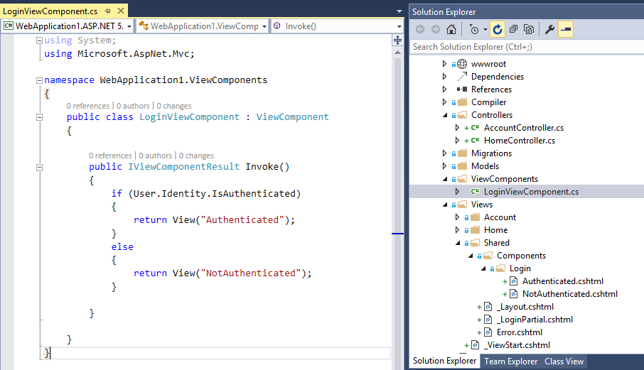

Logic in the component can be unit tested. Views separated from logic

Slide 70
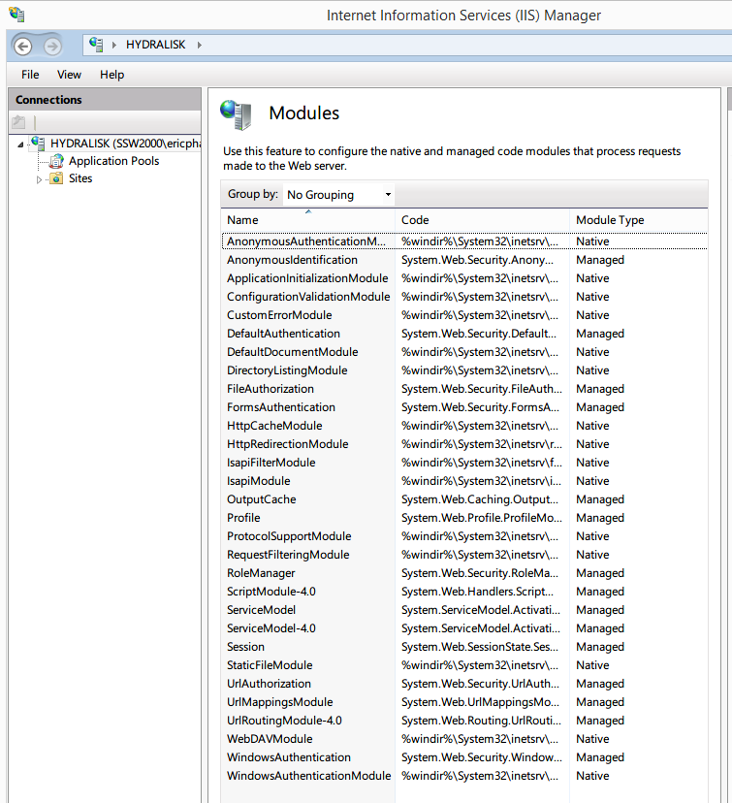
Tip - What can you do to make IIS Faster? Disable Modules

Slide 71
Owin

Slide 72
13. Pre-OWIN
System.Web contains many things that might not be needed e.g. Web Forms
Performance implications
ASP.NET applications bound to IIS due to the heavy dependency on System.Web assembly.
Tightly coupled Web Server and Web Application

Slide 73
What is OWIN?
V1.0 released 10 October 2012
Open standard owin.org
Defines a standard interface between .NET web servers and web applications.
Aims to
Decouple server and application
Encourage the development of simple modules for .NET web development
Stimulate the open source ecosystem of .NET web development tools.

Slide 74
Owin is cool
Previously doing *anything* on ASP.NET would require heaps of assemblies to be loaded that mostly don’t get used (System.XML, etc.)
The new pipeline is lightweight (the old legacy concepts since .NET 1.0 are gone)
Performance - Loaded assemblies in ASP 4.5 app domain was ~25 per request? Now it is down to ~10.
Performance - Cuts the base memory per request down by 1/2.

Slide 75
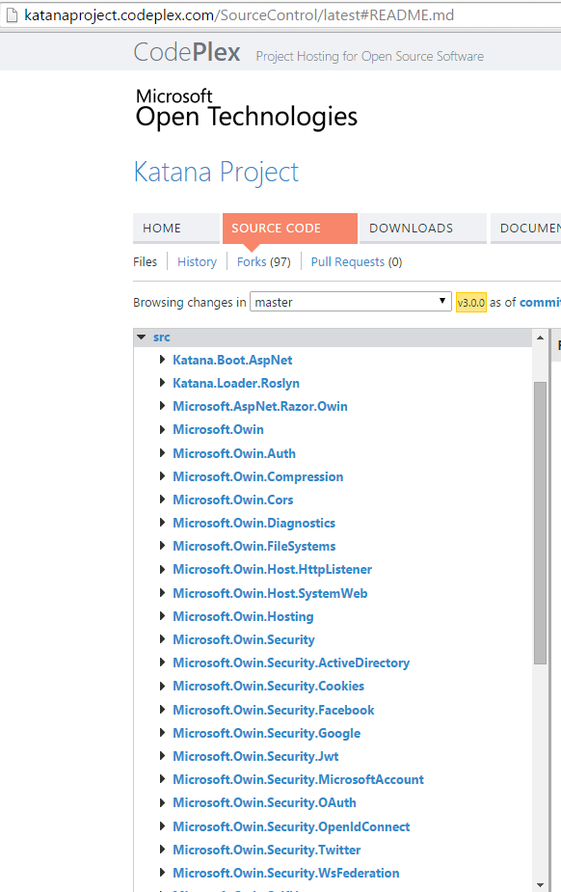
What is Katana?
Katana is a collection of projects for supporting OWIN
Microsoft.OWIN…
Enables self hosting
Custom Host
OwinHost.exe
Paves the way for ASP.NET to be fully OWIN compliant

Slide 76
ASP.NET 5 and OWIN
Fully OWIN compliant
ASP.NET 5 is the next generation of Katana
Applications can to be hosted in
IIS
Self hosted
Hosted in any OWIN Server (E.g. Nowin, Fracture)
Linux or Mac

Slide 77
New Startup.cs in ASP.NET 5
Define what services and features this app will be using via Owin
Services
EF
MVC
Routes
Features
BrowserLink
Static Files
Authentication

Slide 78
Startup.cs
1st Request comes in to an MVC page
2nd Request comes in for an image
Request /Home/Index
Request /Content/logo.png
Register OWIN middleware
Verifies user is logged in and passes onto the next OWIN middleware
Skips check and moves on, because we allow anonymous
app.UseIdentity()
Not a static file, so move onto the next OWIN middleware
app.UseStaticFiles()
Static file handler gets the file and returns to the client
app.UseMvc()
MVC route handles request and returns to the client

Slide 79
AngularJs

Slide 80
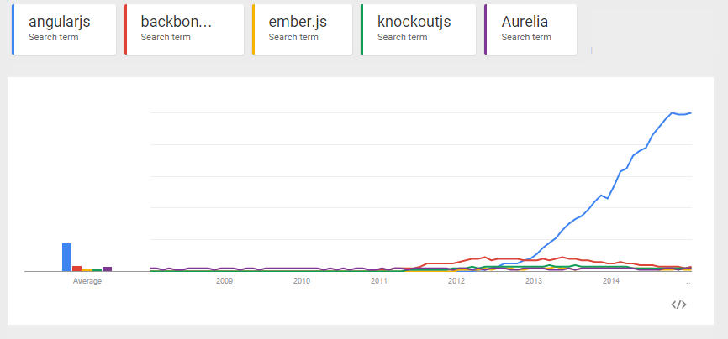
15. AngularJS
Notes:
Dominate the frontend space
Google use it and so many companies have vested interest it is not going any where

Slide 81

AngularJS
http://www.adamcogan.com/2014/11/13/why-ssw-is-moving-to-angularjs/
https://github.com/johnpapa/angularjs-styleguide
http://www.ssw.com.au/ssw/Events/Webinars/DevSuperpowers-AngularJS-with-TypeScript.aspx
http://tv.ssw.com/5682/how-to-make-web-applications-with-angularjs-and-asp-net-mvc-dev-superpowers-episode-7
http://tv.ssw.com/5818/angularjs-with-dan-wahlin

Slide 82

Dev Superpowers - AngularJS with TypeScript made easy with Duncan Hunter

Slide 83

How to make web applications with AngularJS and ASP.NET MVC | Dev SuperPowers Episode 7

Slide 84

The future of AngularJS: an interview with Dan Wahlin

Slide 85
AngularJS + VS2015
Built in templates to create
Controller
Service
Directive
Factory
Module

Slide 86
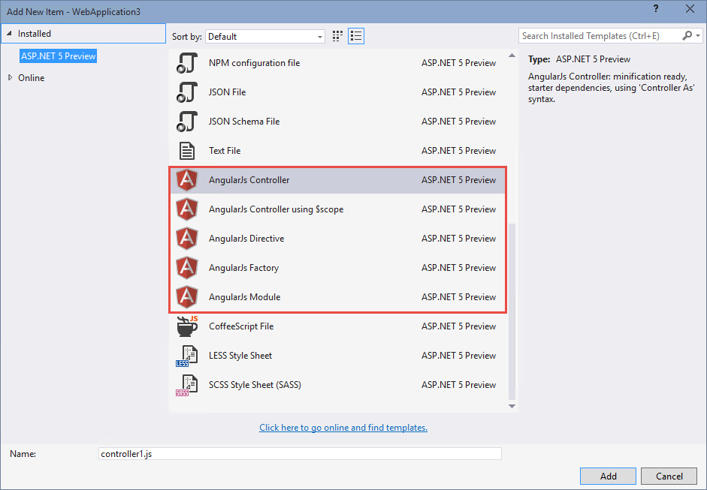

Slide 87
SignalR

Slide 88
16. SignalR
Add via the NuGet package
Real time communication between clients
Good for:
Showing progress on long running tasks
Interactive apps
Team collaboration

Slide 89
SignalR in action
Visual Studio BrowserLink
https://sswhealthcheck.com/
https://sugarlearning.com/Public/healthcheck
https://sswlinkauditor.com/

Slide 90
Typescript

Slide 91
ECMA Script 6
LINQ in javascript!
But… Browser compatibility
http://kangax.github.io/compat-table/es6/
// Old Way
[1,2,3].map(function (x) {
return x * x;
});
// New Way
[1,2,3].map(x => x * x);

Slide 92
Why should you use Typescript?
Supports Lambda expressions already
Can set it to compile to different ECMA Script versions
Better intellisense support in VS
Type & interface validation
Definitely typed libraries available for major libraries and frameworks

Slide 93
Is it hard to move to TypeScript?
“Developers are reluctant to convert because of learning curve or a large code base”
Adam Stephensen
TypeScript is compatible with JavaScript
All JavaScript is valid TypeScript.
Just rename all .js to .ts and tell your boss you are done ;)
“Any” type allows you to gradually opt-in to type checking
At SSW we use the staged approach of changing to TypeScript:
Creating all new files in TypeScript
Converting old files when they are modified

Slide 94
Say goodbye…
ASP.NET 4
ASP.NET 5
No Web Forms
No VB.NET
Faster
Cheaper hosting – Linux
More expensive hosting – Mac ;-)

Slide 95
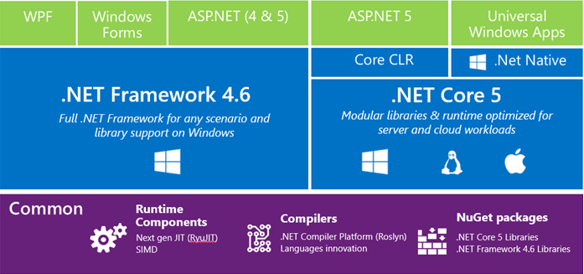

Slide 96
Summary - What’s changed in ASP.NET 5?
project.json (was dependencies)
config.json (was web.config)
Javascript package managers and builders (NPM, Bower, Grunt)
Dependency Injection included
ApiController is Controller
Startup class using OWIN (was \App_Start + global.asax)
Razor Tag Helpers
Compile ahead of time, no need to compile to see changes
More love for Angular

Slide 97
This Year I recommend…
+ KnockoutJS
MVC + WebAPI + TypeScript
+ AngularJS
SPA app front end + WebAPI backend
Use App Insights for usage tracking + DevOps
Xamarin.Forms for native cross platform mobile development
Continuous deployment to Azure using Testing in Production and Deployment Slots
Testing
.NET VS Tests
Selenium
Javascript (Jasmine + Chutzpah)

Slide 98

Summary Thank you: You helped me know what's awesome!
A trip down memory lane
What’s New (2014 + 2015)
Mobile Development
ASP.NET 5 (was vNext)
Azure + Continuous Deployment + Testing
Summary

Slide 99

2 things...

Slide 100
Tweet your favourite feature
@DuncHunter @AdamStephensen #NetUG

Slide 101
Check out tv.ssw.com
Tweet your favourite video @SSWTV

Slide 102
Thank you! info@ssw.com.au www.ssw.com.au Sydney | Melbourne | Brisbane | Adelaide

